Slide 1
SQL SERVER 2014
Change Data Capture
Dave Bland
www.linkedin.com/pub/dave-bland/a/19b/530
@SQLDave29

Slide 2
About me
Degree in Education
Microsoft Certified Trainer since 1998
11 years DBA experience
.NET and BI Developer
Currently supervise a DBA team at Stericycle
SQL Server and SharePoint Instructor at Harper College, Palatine, IL
SQL Server Consultant Einstein Technology Solutions, Lombard, IL

Slide 3
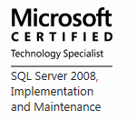
Certifications

Slide 4
Agenda
What is Change Data Capture
Differences between Change Tracking and Change Data Capture
CDC Workflow
Enabling and Using Change Data Capture
CDC Functions
Performance and Best Practices related to CDC
Why Use Change Data Capture
Demo

Slide 5
What is Change data capture
A way to capture changes made to data in a table
Used to capture data for auditing
Can be used to load Data Warehouse

Slide 6
Cdc Requirements
SQL Server Agent Service needs to be running
Enable CDC for database by a member of the sysadmin fixed server role
Enable CDC for individual table by the members of the db_owner fixed database role
Change Data Capture is available only on the Enterprise,
Developer and Evaluation editions of SQL Server
Notes:
The requirements for CDC are pretty simple.
Enable CDC fails with error Msg 22830, Level 16, State 1, Procedure sp_cdc_enable_db_internal, Line 186 - If you get this error it could be solved by changing the database owner to SA

Slide 7
Differences between CDC and Change Tracking
Feature | Change Data Capture | Change Tracking
Tracked changes
DML changes | Yes | Yes
Tracked information
Historical data | Yes | No
Whether column was changed | Yes | Yes
DML type | Yes | Yes
Notes:
There is a difference in the set up and configuration, however in terms of functionality there is a difference. CDC allows for historical changes, while Change Tracking does not.

Slide 8
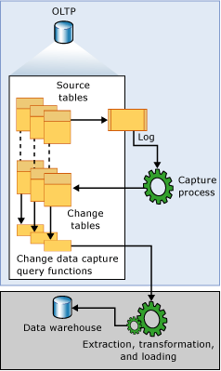
Cdc workflow
DML statements are executed against the tracked tables
Entries made to transaction log
Capture process reads the log
Adds the changes to the Change tables
User uses functions to access the change data
Clean up job removes old data from Change Tables
Images from Microsoft.com
Notes:
Uses the sp_replcmds system stored procedure to capture the changes from the Transaction log. This is the same internal stored proc that Transactional Replication uses.
Transactions in the log that have not been captured by the CDC process will remain until they are. CHECKPOINT will not truncate the Transaction log.

Slide 9
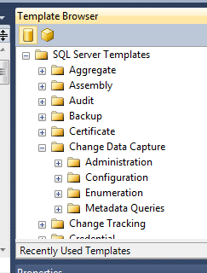
CDC Functions
sys.sp_cdc_add_job
sys.sp_cdc_change_job
sys.sp_cdc_disable_db
sys.sp_cdc_disable_table | sys.sp_cdc_help_change_data_capture
sys.sp_cdc_drop_job | sys.sp_cdc_help_jobs
sys.sp_cdc_enable_db | sys.sp_cdc_start_job
sys.sp_cdc_enable_table | sys.sp_cdc_stop_job
Notes:
Change Data Captures is configured and used via stored procedures. Very little can be completed is Management Studio.
SQL Server 2014 includes a number of templates that can easily be used.

Slide 10
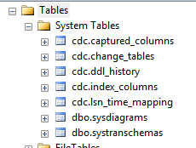
Enable\Disable CDC
EXECUTE
sys.sp_cdc_enable_db
Objects Created
Meta data tables
CDC schema
CDC database user
Sets is_cdc_enabled column
in the Sys.Databases view to 1
EXECUTE sys.sp_cdc_disable_db
Notes:
Cannot be enabled on system databases.
When disabling CDC on a database, the objects created will be deleted.
Does not create the Agent jobs until a table is enabled for CDC.
SQL Server will allow for the creation of the CDC schema.

Slide 11
Enable CDC for a table
EXEC sys.sp_cdc_enable_table @source_schema = N'HumanResources' , @source_name = N'Department' ,
@role_name = N'cdc_admin' ,
@capture_instance = N'HR_Department' ,
@supports_net_changes = 1 ,
@index_name = 'AK_Department_Name' ,
@captured_column_list = N'DepartmentID, Name, GroupName' , @filegroup_name = N'PRIMARY'; GO
Will create two Agent jobs
One to Capture the Changes
One to clean up
@supports_net_change - Determines if procs to capture net change(1) and\or All changes(0). Defaults to 1 if Primary Key detected or unique index Index name provided using the @index_name parameter
Notes:
A role for controlling access to a change table.
The purpose of the named role is to control access to the change data. The specified role can be an existing fixed server role or a database role. If the specified role does not already exist, a database role of that name is created automatically. Members of either the sysadmin or db_owner role have full access to the data in the change tables. All other users must have SELECT permission on all the captured columns of the source table. In addition, when a role is specified, users who are not members of either thesysadmin or db_owner role must also be members of the specified role.
If you do not want to use a gating role, explicitly set the @role_name parameter to NULL. See the Enable a Table Without Using a Gating Role template for an example of enabling a table without a gating role.
EXEC sys.sp_cdc_enable_table @source_schema = N'dbo', @source_name = N'MyTable', @role_name = N'MyRole', @filegroup_name = N'MyDB_CT', @supports_net_changes = 1 GO
[ @supports_net_changes = ] supports_net_changesIndicates whether support for querying for net changes is to be enabled for this capture instance. supports_net_changes is bit with a default of 1 if the table has a primary key or the table has a unique index that has been identified by using the @index_name parameter. Otherwise, the parameter defaults to 0.
If 0, only the support functions to query for all changes are generated.
If 1, the functions that are needed to query for net changes are also generated.
If supports_net_changes is set to 1, index_name must be specified, or the source table must have a defined primary key.
Is the filegroup to be used for the change table created for the capture instance. filegroup_name is sysname and can be NULL. If specified, filegroup_name must be defined for the current database. If NULL, the default filegroup is used.
We recommend creating a separate filegroup for change data capture change tables.
[ @capture_instance = ] 'capture_instance'Is the name of the capture instance used to name instance-specific change data capture objects. capture_instance is sysname and cannot be NULL.
If not specified, the name is derived from the source schema name plus the source table name in the format schemaname_sourcename. capture_instance cannot exceed 100 characters and must be unique within the database. Whether specified or derived, capture_instance is trimmed of any white space to the right of the string.
A source table can have a maximum of two capture instances. For more information see, sys.sp_cdc_help_change_data_capture (Transact-SQL).
The name of a unique index to use to uniquely identify rows in the source table. index_name is sysname and can be NULL. If specified, index_name must be a valid unique index on the source table. If index_name is specified, the identified index columns takes precedence over any defined primary key columns as the unique row identifier for the table
CDC tables are placed in the default filegroup by default
Subsequent changes to the primary key will not be allowed without first disabling change data capture for the table.

Slide 12
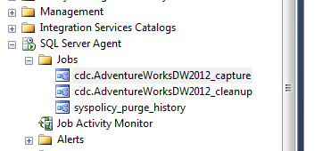
First cdc table
Job 'cdc.AdventureWorksDW2012_capture' started successfully.
Job 'cdc.AdventureWorksDW2012_cleanup' started successfully.

Slide 13
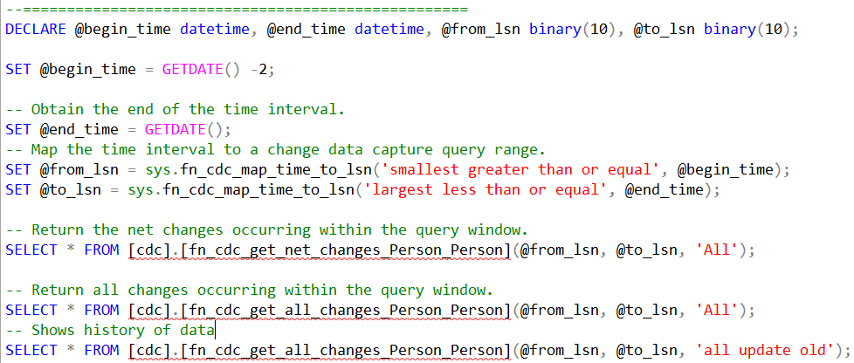
Getting changes….

Slide 14
Getting Changes….
Notes:
Column name
Data type
Description
__$start_lsn
binary(10)
Commit LSN associated with the change that preserves the commit order of the change. Changes committed in the same transaction share the same commit LSN value.
__$seqval
binary(10)
Sequence value used to order changes to a row within a transaction.
__$operation
int
Identifies the data manipulation language (DML) operation needed to apply the row of change data to the target data source. Can be one of the following:
1 = delete
2 = insert
3 = update (captured column values are those before the update operation). This value applies only when the row filter option 'all update old' is specified.
4 = update (captured column values are those after the update operation)
__$update_mask
varbinary(128)
A bit mask with a bit corresponding to each captured column identified for the capture instance. This value has all defined bits set to 1 when __$operation = 1 or 2. When __$operation = 3 or 4, only those bits corresponding to columns that changed are set to 1.
<captured source table columns>
varies
The remaining columns returned by the function are the captured columns identified when the capture instance was created. If no columns were specified in the captured column list, all columns in the source table are returned.

Slide 15
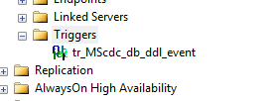
DDL History
Stored in the cdc.ddl_history table
Is populated using a trigger
Captures command, but not the user

Slide 16
Capture Job Parameters
Set by using the sys.sp_cdc_change_job stored procedure
Using the default values, the most number of transactions that can be grabbed every 5 seconds is 5000
Maxtrans Parameter - Default value 500
The maxtrans parameter specifies the maximum number of transactions that can be processed in a single scan cycle of the log
Maxscans Parameter - Default value 10
The maxscans parameter specifies the maximum number of scan cycles that are attempted to drain the log
Pollinginterval Parameter – Default is 5 seconds
The amount of time to wait between log scans

Slide 17
Database recovery model
Once change data capture is enabled, the transaction log
behaves just as it does with transactional replication—the log
cannot be truncated until the log reader has processed it.
A checkpoint operation, even in SIMPLE recovery mode, will not
truncate the log unless it has already been processed by the logreader
BULK_LOGGED recovery model is used to reduce logging, change data capture will force everything to become fully logged, except for index create/drop/rebuild operations.

Slide 18
Back up and restore
If a database is restored to the same server with the same database name
If a database is restored to another server
If a database is detached and attached to the same server or another server, CDC remains
If a database is attached or restored with the KEEP_CDC option to any edition other than Enterprise
Notes:
If a database is restored to the same server with the same database name, change data capture remains enabled.
If a database is restored to another server, by default change data capture is disabled and all related metadata is deleted.
To retain change data capture, use the KEEP_CDC option when restoring the database.
If a database is detached and attached to the same server or another server, change data capture remains enabled.
If a database is attached or restored with the KEEP_CDC option to any edition other than Enterprise, the operation is blocked.

Slide 19
Reasons to use CDC
There is reduced development time
Schema changes are not required.
There is a built-in cleanup mechanism
There is low overhead to DML operations.
Change Data Capture is based on committed transactions.
Standard tools are available that you can use to configure and manage

Slide 20
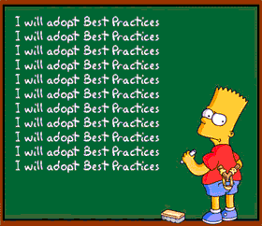

Slide 21
Cdc best practices
Change data capture cannot function properly when the Database Engine service or the SQL Server Agent service is running under the NETWORK SERVICE account. This can result in error 22832.
To prevent log scanning from adding load during periods of peak demand is to stop the capture job and restart it when demand is reduced.
Avoid having two Capture instances on the same table
Create a designated File Group for the Change Data
Try to avoid using change data capture to capture changes to tables that have frequent large update transactions
Continued on next slide

Slide 22
Cdc best practices
Limit the list of columns captured by change data capture to only the columns you really need to track
If change data capture with default parameters cannot keep up with the workload and latency becomes too high, adjust the Maxscans and/ormaxtrans or you can reduce pollinginterval to 1.
If possible, run cleanup when there is no other workload active
When planning change data capture architecture, take a significant increase in log size and log volume I/O operations into account.
In general, querying for all changes is more efficient than querying for
net changes
Coordinate ETL jobs and Clean up job

Slide 23
What’s next
CDC SSIS packages
Monitoring Change Data Capture
Data Management Views
Notes:
sys.dm_cdc_log_scan_sessions - Returns one row for each log scan session in the current database. The last row returned represents the current session. You can use this view to return status information about the current log scan session, or aggregated information about all sessions since the instance of SQL Server was last started.
sys.dm_cdc_errors - Returns one row for each error encountered during the change data capture log scan session.

