Slide 1
SQL Server Analysis Services Fundamentals
Dave Bland
daveb8782@gmail.com

Slide 2
Thank you Sponsors

Slide 3
About Me
Dave Bland
14 years DBA Experience
Teaching SQL Server since 1999
Frequent SQL Saturday presenter in Midwest
SQL Server Instructor at Harper College, Palatine, IL
Currently supervise a team of DBAs at Stericycle
DBA consultant for Einstein Technology Solutions, Lombard, IL

Slide 4
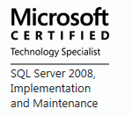
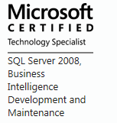
Certifications

Slide 5
Agenda
SSAS Fundamentals
SSAS Security
Cube Processing
Database Backups
How to read the data

Slide 6
What is SSAS and Why Use it
“Analysis Services is an online analytical data engine used in decision support and business intelligence (BI) solutions, providing the analytical data for business reports and client applications such as Excel, Reporting Services reports, and other third-party BI tools” - Microsoft.com
SSAS can be used for data analysis
Reports
Trending
Predictive Analytics

Slide 7
Microsoft Business Intelligence Technologies
Microsoft SQL Azure
and the Windows Azure Marketplace
Microsoft SQL Server Integration Services
Data Warehousing

SQL Server Database Engine
1011000110
SQL Server Master Data Services
SQL Server Data Quality Services
SQL Server
Analysis Services
SQL Server
Reporting Services
Microsoft PowerPivot Technologies
Business Intelligence
Interactive data analysis
Microsoft Excel
Data Mining Add-In
PowerPivot Add-In
MDS Add-In
Interactive data visualizations
Power View
Microsoft SharePoint Server
Reports, KPIs, and Dashboards

Slide 8
OLAP vs OLTP

Slide 9
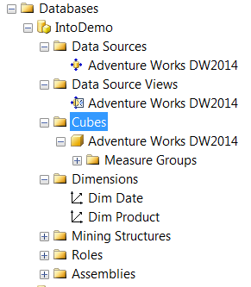
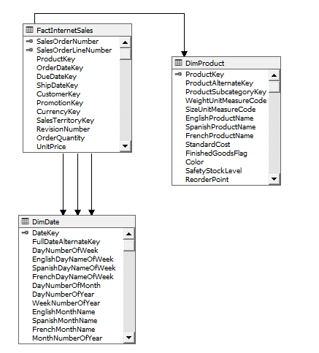
Analysis Services Project
Database
Data Source
Data Source View
Cube
Role

Slide 10
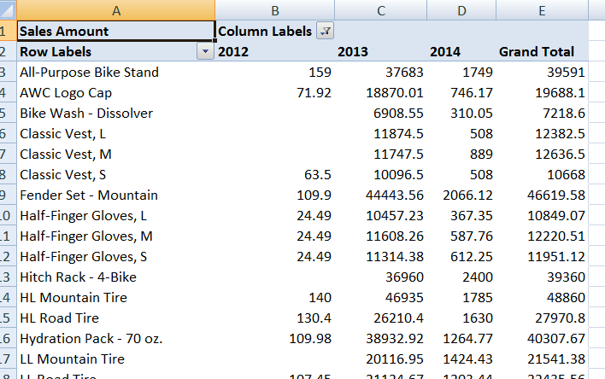
Analysis Services Terminology
Measure
Dimension
Attributes
Members

Slide 11
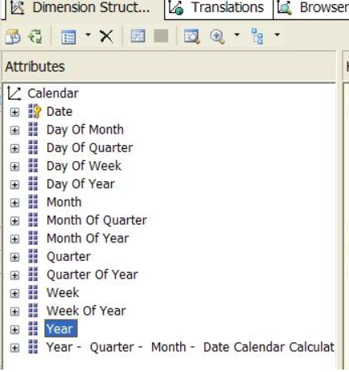
Time Dimension
Used to aggregate measures by time
Year over Year considerations
Holidays
Generally create for years in future
Can use the wizard, in Data Tools

Slide 12
Model Types
Two Types
Multidimensional
Tabular
Feature | Multidimensional | Tabular
Query Language | MDX | MDX and DAX
Storage | Disk | Memory or Disk
Sample Query | SELECT { [Measures].[Sales Amount], [Measures].[Tax Amount] } ON COLUMNS, { [Date].[Fiscal].[Fiscal Year].&[2002], [Date].[Fiscal].[Fiscal Year].&[2003] } ON ROWS FROM [Adventure Works] WHERE ( [Sales Territory].[Southwest] ) | evaluate( Filter( FactInternetSales , FactInternetSales[OrderDateKey]>20030101) )
Functions | MDX | Similar to Excel

Slide 13
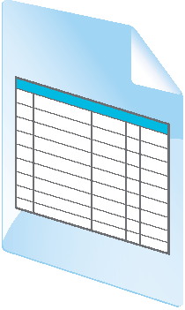
Analysis Services Terminology
Process
Reporting and Analysis
Data Models
Data Sources
Data
Warehouse

ETL

Slide 14
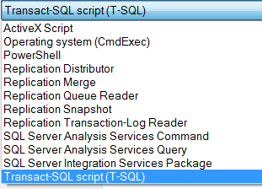
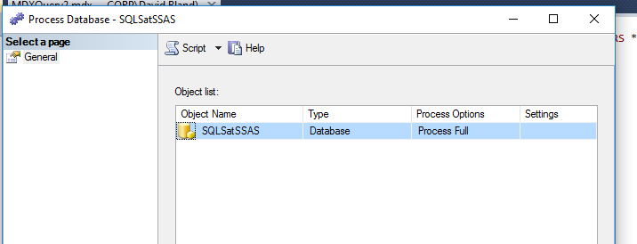
Processing a Cube
Types of Processing
Full
Incremental
Can process individual parts of the cube
Uses XMLA
SQL Agent Job
SSIS task
SQL Server Management Studio
Let SSMS generate script

Slide 15
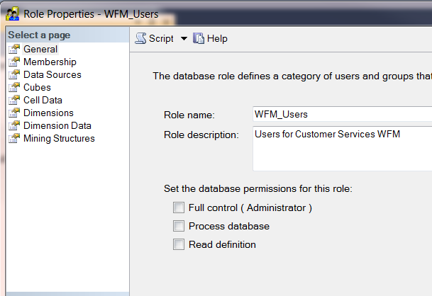
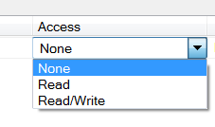
SSAS Security
Is Role based
Uses Windows Authentication

Slide 16
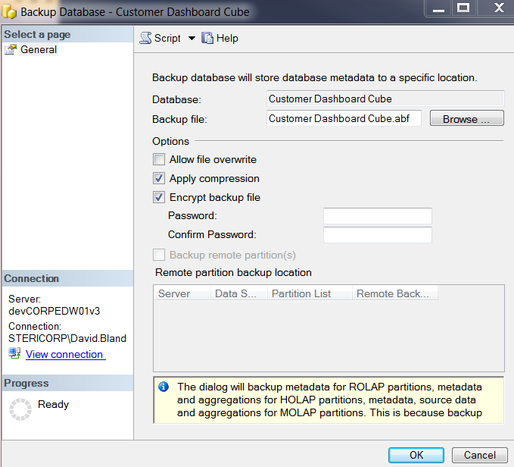
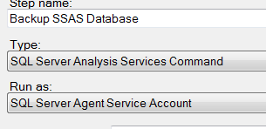
Backup Database
Backup Database, not just the cube
Determine if there is a need to backup the database
<Backup xmlns="http://schemas.microsoft.com/analysisservices/2003/engine">
<Object>
<DatabaseID>AdventureWorksCube</DatabaseID>
</Object>
<File>\\AWCorp\backups\StorageWorks\AW\SSAS\AWBackup.abf</File>
</Backup>

Slide 17
What would we want to know about a player
Dimensions
Gender
Postal Code
Age
Type of Game
Section of boat
Day of Week
Facts
Coin In
Win\Loss
Jackpots
Buy In
Hour of Day
Day of Year
Year
Month

Slide 18
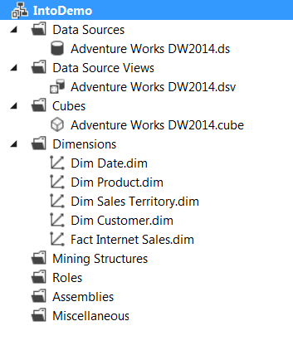
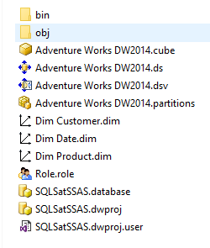
Data Tools
Is a project type
Data Source
Data Source View
Cubes
Dimensions
Roles

Slide 19
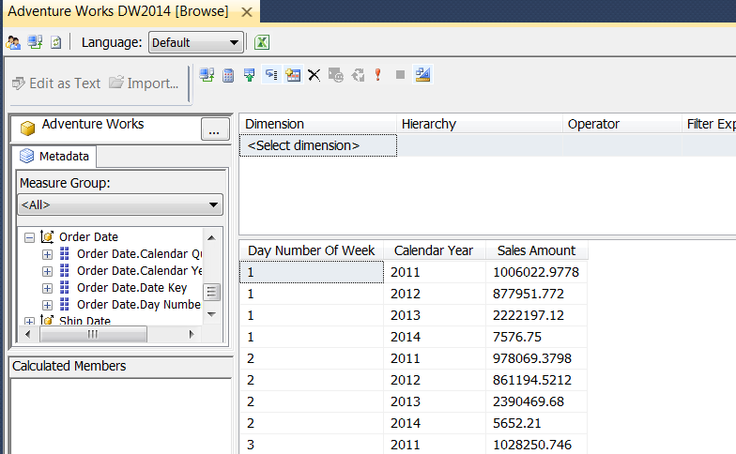
How to get the Data
SQL Server Management Studio
Excel
MDX
DAX
Reporting Services
Third Party Reporting Tools

Slide 20
Questions?
Thank You

